Slide 1
Impact of COVID-19 on Stock Market
Applied Machine Learning (CPE 695) - Spring 2020
Guided by: Dr. Shucheng Yu
Team 14:
Chirag Sharma
Prem Patel
Shreya Bhargava
May 10, 2020

Slide 2
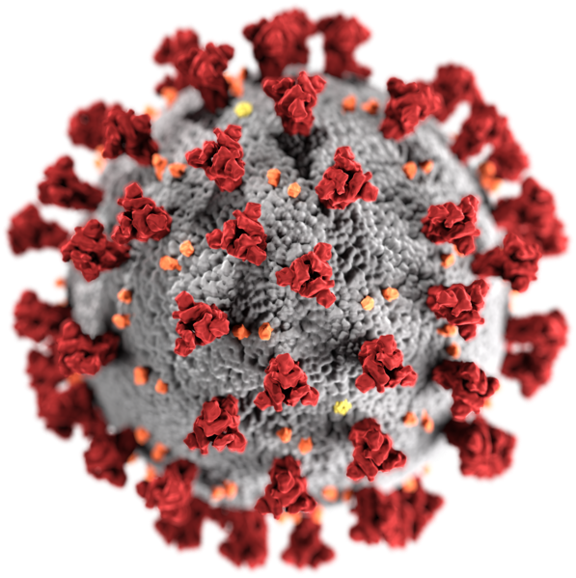
Introduction - COVID-19
COVID-19 is an infectious disease caused by a newly discovered coronavirus.
Most people infected with COVID-19 virus will experience mild to moderate respiratory illness and recover without requiring special treatment. Older people, and those with underlying medical problems like cardiovascular disease, diabetes, chronic respiratory disease, and cancer are more likely to develop serious illness.
Protect yourself and others from infection by washing your hands or using an alcohol-based rub frequently and not touching your face.
The COVID-19 virus spreads primarily through droplets of saliva or discharge from the nose when an infected person coughs or sneezes. At this time, there are no specific vaccines or treatments for COVID-19. However, there are many ongoing clinical trials evaluating potential treatments

Slide 3

Introduction - Financial Crisis
As countries implement necessary quarantines and social distancing practices to contain the pandemic, the world has been put in a Great Lockdown.
In addition, many countries now face multiple crises—a health crisis, a financial crisis, and a collapse in commodity prices, which interact in complex ways.
Under the assumption that the pandemic and required containment peaks in the second quarter for most countries in the world, the World Economic Outlook project global growth to fall by 3%. This is a downgrade of 6.3 percentage points from January 2020, a major revision over a very short period.

Slide 4
About the Project
Stock market prediction has been existing since long however it has either predicted the future value of one specific company or predicted the value of indexes. As per our literature survey is concerned particle swarm optimization (PSO) has been widely used to predict the stocks of one specific company.
PSO has been used mainly because of its intuitiveness, ease of implementation and ability to solve nonlinear optimization problem.
However the PSO algorithm has a very low convergence rate in case of complex problems such as stock prediction and easily tends to fall into local optimum in high dimensional space. PSO cannot avoid the problem of scattering and furthermore it is difficult to implement it with initial design parameters.
We have tried to predict stocks based on industry and how adversely it has been affected by the outbreak. Since, COVID-19 is fairly new, there is no existing solution available which integrates COVID-19 and its impact on stock market and loss of economy.

Slide 5
Datasets used
COVID- 19 (Updated daily)
Confirmed, Recovered, and Deaths with Province/State, Country/Region, Last Update
1
Stock Market Data (Updated Daily)
Open, Low, High, Date, Close, and Adj_Close
2
S&P 500 companies (Static data)
Company, Symbol, Sector
3

Slide 6
Data Cleaning and Preparation
1
COVID-19 data has been collected through the URL Request method to download the csv and dump it into a dataframe. We are saving the files on the local machines to keep a copy of the latest file used as these datasets are updated daily.
These are three different datasets for Confirmed, Recovered, and Deaths with Province/State, Country/Region, Last Update as common columns in all three.
2
3
We remove unnecessary columns and only keep Date, Confirmed, Recovered, and Death merging all three columns into one dataframe using pandas.merge.
Since, the S&P 500 companies’ data is static, we load this data from our local machine through pandas.read_csv method and dump the company symbols in a list.
4
5
For stock market data, we are using yfinance module to download data for all 500 companies by looping in the symbol list created earlier and create new columns for each company’s Open, Low, High, Date, Close, and Adj_Close columns. Some companies’ data is not found as they might be delisted.

Slide 7
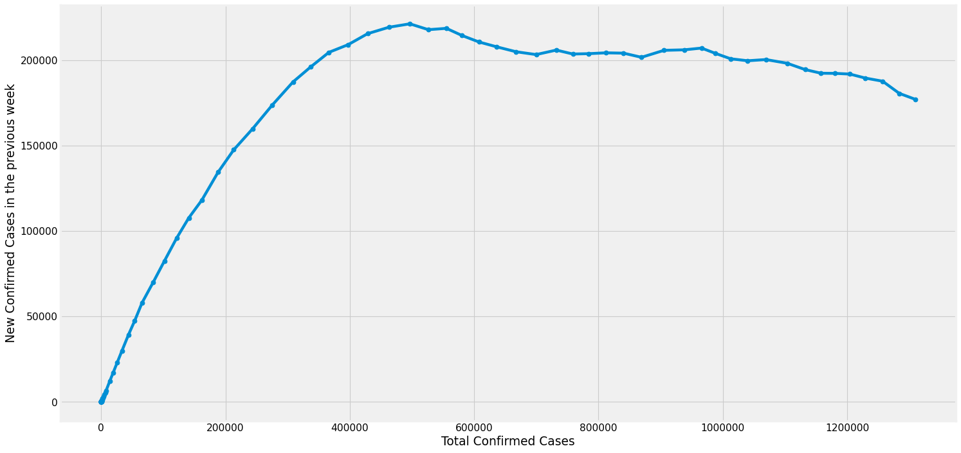
Exploratory Data Analysis
Current Week
We have attempted the understand the COVID-19 situation for USA to gauge the confidence level in our results
Instead of plotting the number of confirmed cases with time, we will plot it with the number of new confirmed cases in the last week
This is because COVID-19 is not time dependent directly but it is dependent on new cases per week
As our graph suggests, the exponential growth of COVID-19 has depleted with time and the curve has begun to not only flatten but have also started to dip.
We can safely assume that the COVID situation is not getting worse and have more confidence in our results before of the reduced ambiguity.

Slide 8
Algorithms used
Linear Regression
Long Short Term Memory
Support Vector Regression

Slide 9
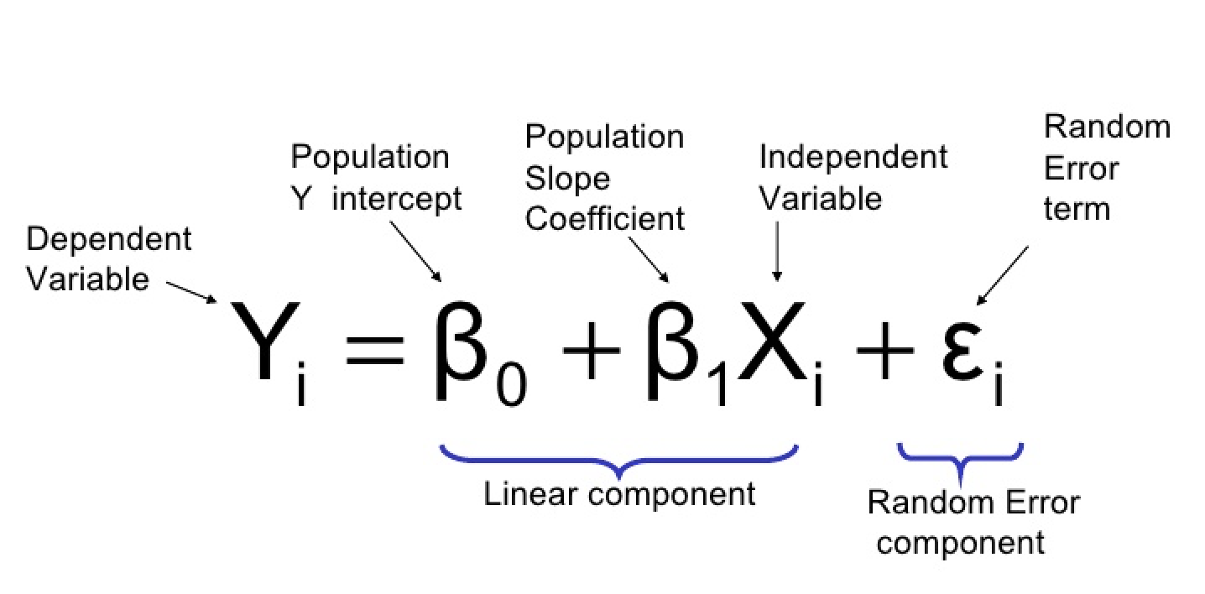
Linear Regression
Relationship between Dependent and Independent Variables
Dependent Variable: Adj Close
Independent Variable: Open, High, Low, Volume, Confirmed Cases
Splitting the data into train (70 %) and test (30 %)
Metrics used for interpretation:
Mean Squared Error: (Y_Test) - (Y_Predicted)
Variance: Closer to 1, the better it is.
Prone to Outliers

Slide 10
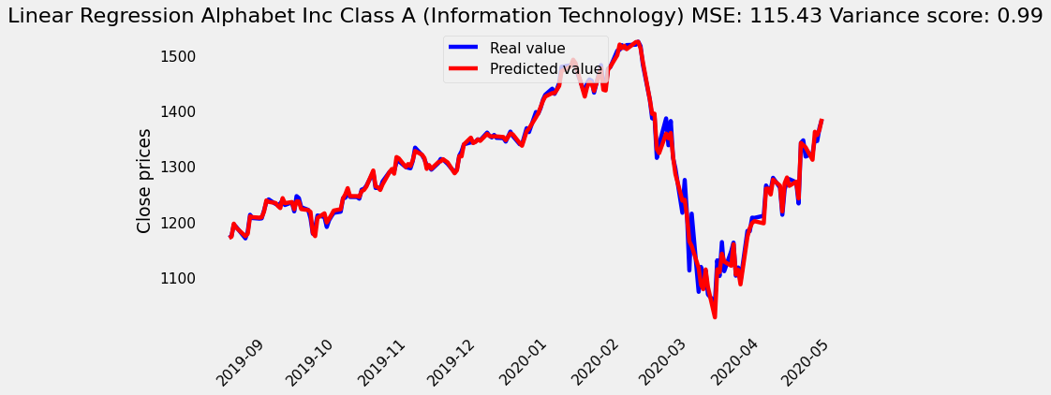
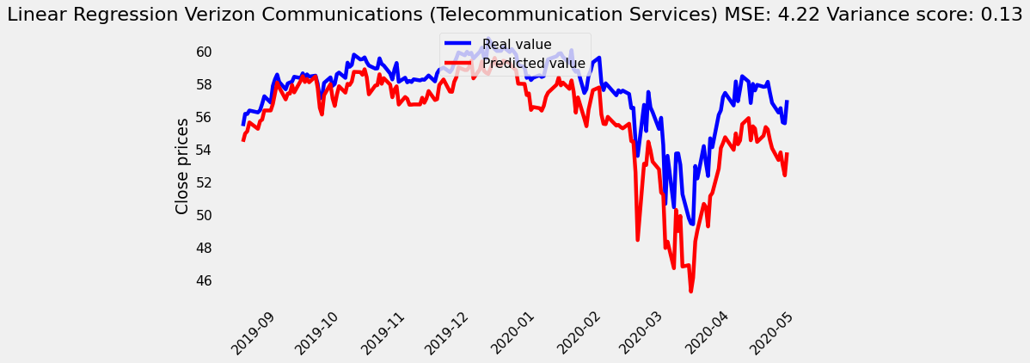
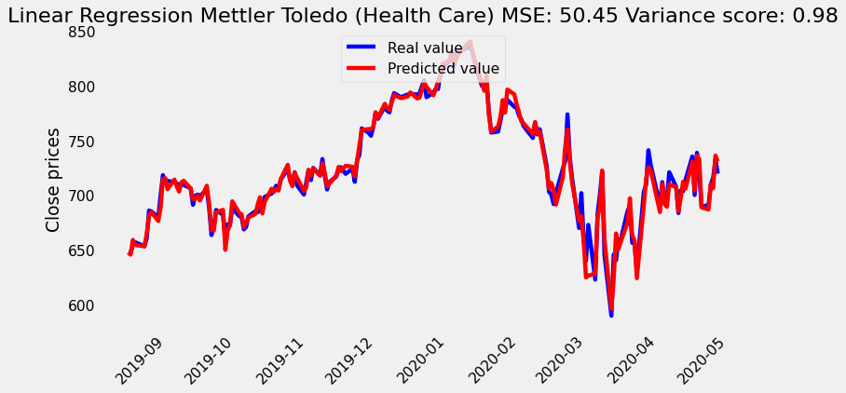
Linear Regression - Output
Interpretation:
Data fits well, example of overfitting
Information Technology Sector (High Error, High Variance)
Telecommunication Services (Low Error, Low variance)
Health Care (High Error, High Variance)

Slide 11
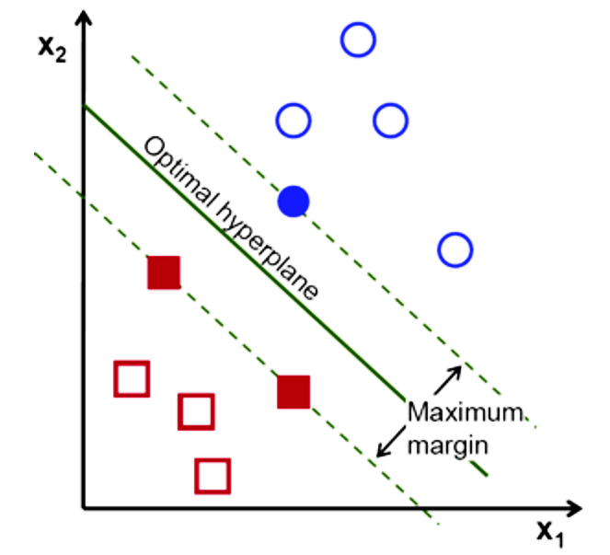
Support Vector Regression
Combination of Support Vector Machines & Regression
Using Regression - minimise cost function
Using SVM - hyperplane between 2 different classes
Minimizing the error within a certain threshold
Predict the next value in series
Goal: Minimise error & maximise the margin distance

Slide 12
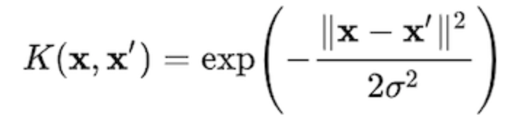
Support Vector Regression
Reshape the data into 1D vector before we feed the data into SVR
Kernels: Map lower dimensional data to high dimensional data
Function takes the squared euclidean distance between 2 samples and divides by some sigma value
RBF transfers 2D space into higher dimension to fit the data better
C: Regularization Parameter (Misclassification)
We choose C = 1e3
Algorithm will choose small-margin hyperplane
A lower value of Gamma loosely fits the training data, considering only nearby points in calculating the separation line

Slide 13
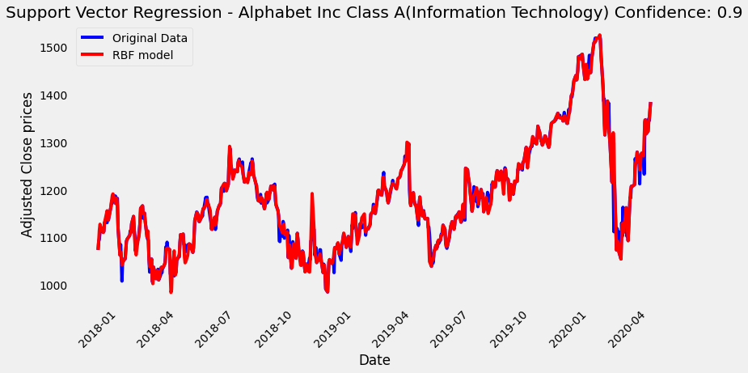
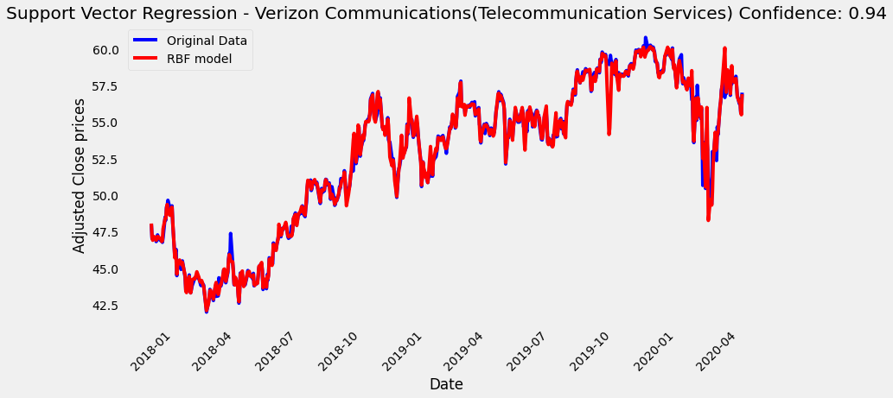
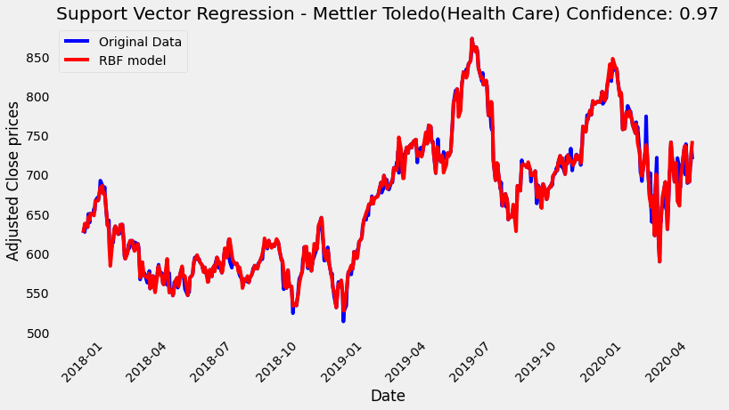
Support Vector Regression - Output
Interpretation:
Data fits well, example of overfitting
Impact by COVID-19::
Information Technology Sector (High)
Telecommunication Services
Healthcare (Low)

Slide 14
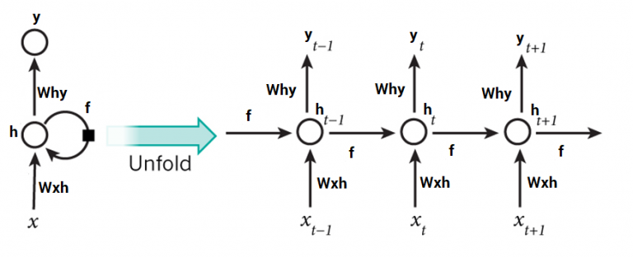
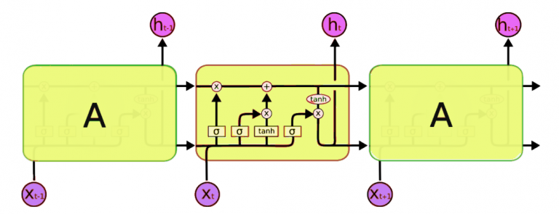
Why Long Short - Term Memory (LSTM)?
One of the shortcomings of using Regression models like Linear Regression and Support Vector Regression is that there is a high possibility of overfitting
LSTMs have an edge over conventional feed-forward neural networks and RNN because of their property of selectively remembering patterns for long durations of time
Architecture of RNN
Architecture of LSTM

Slide 15
Implementing LSTM
LSTM Model:
A sequential model which is a linear stack of 4 LSTM layers and 1 Dense layer is used
The first layer is an LSTM layer with 60 memory units and it returns sequences to ensure that the next LSTM layer receives sequences and not just randomly scattered data
A dropout layer is applied after each LSTM layer to avoid overfitting of the model
Finally, we have the Dense layer as a fully connected layer with a ‘linear’ activation
While compiling the model the Optimizer used is ‘Adam’ and the loss function used is ‘mean_squared_error’
We have iterated this model for 50 epochs

Slide 16

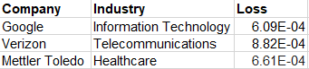
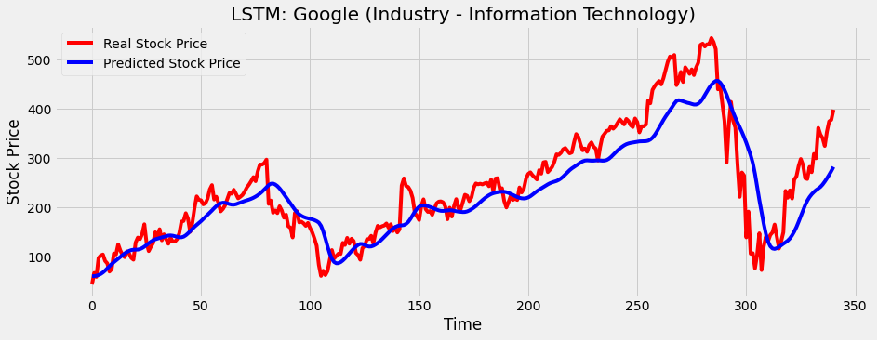
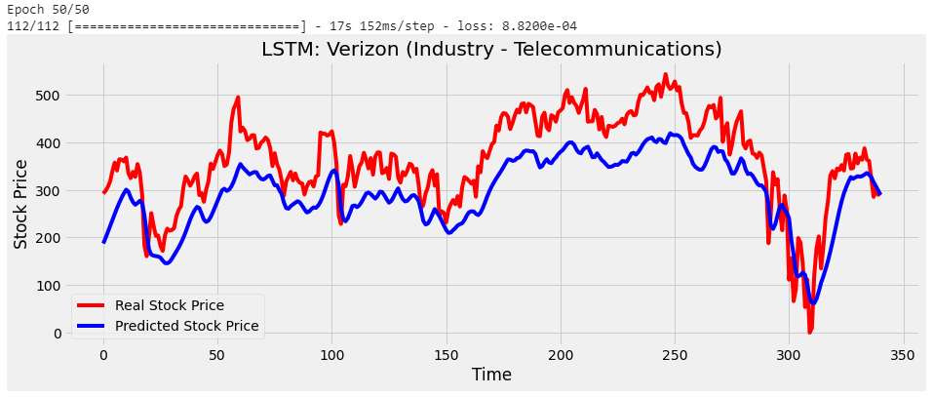
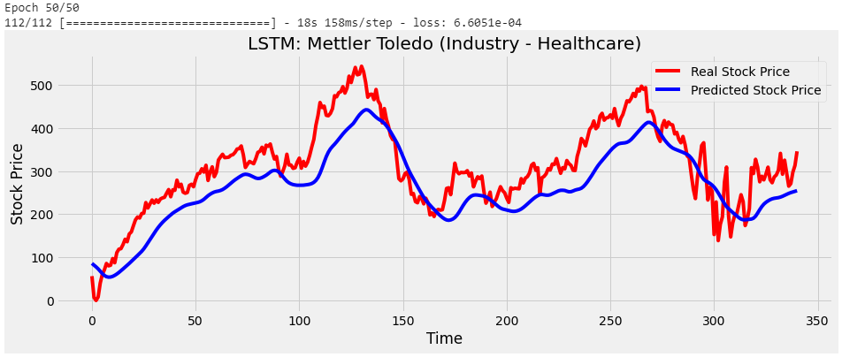
Results using LSTM
Metric used is Loss: There is no overfitting as seen in case of Linear Regression and SVR

Slide 17
Conclusion
COVID-19 crisis is stable than before and results are more reliable because of curve dipping/flattening
Our findings tell us that Linear Regression and Support Vector Regressors give accurate results at the cost of overfitting the data heavily
Linear Regression doesn’t give reliable results with fewer features
Support Vector Regression doesn’t support perform against large datasets and noise
Industries like Healthcare and Telecommunication are relatively less affected by the COVID-19 crisis while Information Technology and Consumer Discretionary are relatively highly affected.
LSTM proves to be the best algorithm for stock market prediction. However, the loss drastically increases with decrease in quantity of data and iterations. The computational power required is also high.

Slide 18

Future Scope
Building a dashboard to customize visual reports
Having custom filters like companies, industries, and impact
Migrating the machine on cloud to automate live data collection
Exporting timely reports to the dashboard
Push notifications about alerts regarding companies to perform well and poor taking into the account of our analysis.

Slide 19
References
https://data.humdata.org/dataset/novel-coronavirus-2019-ncov-cases
https://datahub.io/core/s-and-p-500-companies
https://www.who.int/health-topics/coronavirus
https://blogs.imf.org/2020/04/14/the-great-lockdown-worsteconomic-downturn-since-the-great-depression/
https://www.marketplace.org/2020/04/17/how-the-markets-are-reacting-to-covid-19/
https://www.analyticsvidhya.com/blog/2018/10/predicting-stock-price-machine-learningnd-deep-learningtechniques-python/

Slide 20
Thank you!

